Slide 1
Foundation of Operations Management

Slide 2
OM Defined
Operations Management (OM): is the management of processes used to design, supply, produce, and deliver valuable goods and services to customers.
Supply: Products or services offered to customers
Demand: Products or services customers want

Slide 3
Importance of OM
O M activities create and enhance the value of goods and services by way of the following:
How resources are developed and used to accomplish business goals.
OM is about designing, executing, and improving business processes.
OM deals with processes that transform inputs into goods and services.
OM brings together four major sets of players: the firm, customers, suppliers, and stakeholders.
OM must be consistent with the strategic goals of the firm to be effective.
OM is dynamic because of changes in customers’ demands, resources, competition, and technologies.

Slide 4
Why Study Operations Management (O M)?
Applications of OM are Everywhere
Products
Services
Schools
Hospitality
Restaurants
Banks
Construction
Military
Agriculture
Health care
Sports teams
Transportation
Municipalities
Manufacturers
Retail
Government services
Not-for-profit organizations
Entertainment

Slide 5
OM: Important Decisions What? How? When? Where and Who?
What?
types of goods and services to be delivered.
product features customer care about.
activities and resources are needed, how they should be developed, allocated, and controlled.
How?
is the good and service designed, made, and delivered.
much should transformation process be able to deliver.
should performance be measured and assessed.

Slide 6
OM: Important Decisions What? How? When? Where and Who?
When?
should products be made, activities be carried out, services be delivered, or capacities/facilities come online?
Where?
should certain activities be done.
Who?
should do them: suppliers, partners, or the firm?
is the goods or services to be designed, made, and delivered?

Slide 7
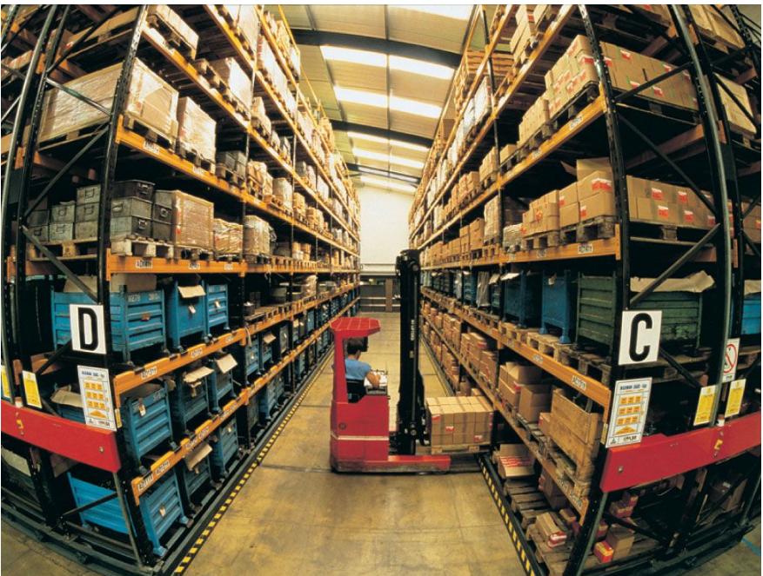
Functional Activities that Connect Operations Managers
Customer Management: mediation/interfacing between customers and the order processing and fulfillment side of the operation.
Supply Management: processes to identify, acquire, and administer inputs.
Logistics Management: movement of materials and information within, into, and out of the firm.

Slide 8
OM Partners
Individuals or organizations that provide inputs to operational processes. Suppliers can be:
Upstream suppliers.
Downstream retailers.
Resource and technology suppliers.
Aftermarket suppliers.

Slide 9
Definitions
Upstream: the parts of the process that are at the beginning of the process flow
Downstream: the parts of the process that are at the end of the process flow

Slide 10
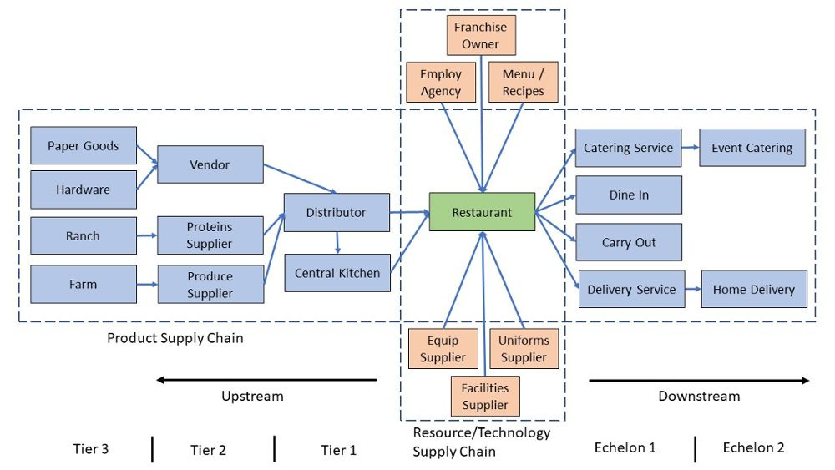
OM Network Example

Slide 11
Process Definition, Scope, and Flow Units
What should the manager measure to determine if the process is performing well?
Managers face the same questions everyday.
Is the process performing well?
How can we make the process better?

Slide 12
Process Definition, Scope, and Flow Units
Process: A set of activities that take a collection of inputs, perform some work or activities with those inputs, and then yield a set of outputs
Resources: Workers or machines that transform inputs into outputs
Process Scope: The set of activities and processes included in the process
Flow Unit: The unit of analysis that is considered in a process analysis

Slide 13
How to Draw a Process Flow Diagram
The process flow diagram provides a visual chart that represents the steps of a process.
Process Analysis is a rigorous framework for understanding the detailed operations of a business that can be used by everyone running a business.
Process flow diagram: A graphical way to describe the process. It uses boxes to depict resources, arrows to depict flows, triangles to depict inventory locations, and diamonds to depict decisions.

Slide 14
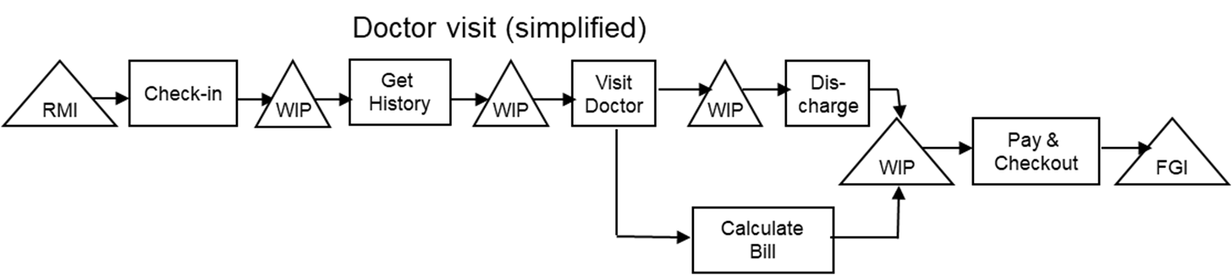
Process Flow Diagram
The best way to begin any analysis of an operation is by drawing a Process Flow Diagram.
Arrows to depict Flows of Flow Unit
Triangles to depict Inventory
Diamond to depict Decision Point
Boxes to depict Activities/Tasks
3-4

Slide 15
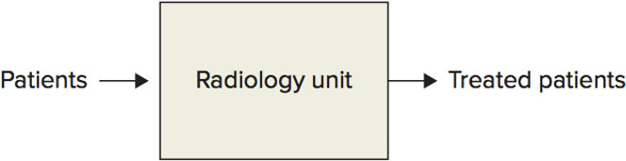
Process Flow Diagram
A simple process flow diagram of a hospital radiology unit

Slide 16
Check Your Understanding
Which of the following is an appropriate flow unit for a roller coaster at an amusement park?
A. Seats on the roller coaster
B. Riders
C. Employees
D. Miles per hour (i.e., speed of the roller coaster)
E. Operating hours per day

Slide 17
Check Your Understanding
The correct answer is
B
Explain…

Slide 18
Rules to Define Flow Unit
Choose a flow unit that corresponds to what you want to track and to measure in the process.
Choose a flow unit that can be used to measure and describe all activities within the process.
Stick with the flow unit you define.

Slide 19
Three Key Process Metrics
Inventory tells us how much “stuff” (flow units) is in the process. Inventory requires space and can cost money (for example, more patients may necessitate a larger waiting room, more products may necessitate a larger store).
Flow rate tells us the rate at which “stuff” (flow units) travel through the process. More units flowing through a process (high flow rate) is generally desirable because the goal of the process is to produce output.
Flow time tells us how much time a flow unit spends in the process. In manufacturing, low flow times are generally desirable since that means flow units move through the process more quickly from start to finish.

Slide 20
Three Key Process Metrics
Process Metric: A scale or measure that informs us about the performance and capability of a process
Inventory: The number of flow units within a process (measured in number of flow units, for example, 30 patients)
Flow Rate: The rate at which flow units move through the process (measured in number of flow units per unit of time, for example, 25 patients per day)
Flow Time: The time a flow unit spends in a process from start to finish (measured in time units, for example, 35 minutes)

Slide 21
Check Your Understanding
Question:
Over the course of an 8-hour day, a dentist’s office treats an average of 24 patients. What is the hourly average flow rate of patients in this dentist’s office?

Slide 22
Check Your Understanding
Question:
Over the course of an 8-hour day, a dentist’s office treats an average of 24 patients. What is the hourly average flow rate of patients in this dentist’s office?
Answer:

Slide 23
Little’s Law
Little’s Law: The law describing the relationship between the three key process metrics:
Inventory = Flow rate x Flow time
I = R x T
where I = Inventory
R = Flow rate
T = Flow time

Slide 24
Little’s Law
If you know (or observe) any of the two key process metrics, you can use Little’s Law to derive the third.
Inventory = Flow rate x Flow time
I = R x T
Therefore, R = I / T and T = I / R
Little’s Law refers to averages for the three key process metrics; for example, the average inventory level, the average flow rate, or the average flow time. The values for individual flow units can vary.

Slide 25
Check Your Understanding
Question:
During a typical Friday, the West Campus Donut Shop serves 2,400 Rice students during the 10 hours it is open.
A student spends (on average) 5 minutes in the shop.
How many students (on average) are in the shop simultaneously?

Slide 26
Check Your Understanding
Answer:
2,400 students / 10 hours = 240 students per hour
(240 students / hour) / 60 = 4 students per minute
Therefore, Flow Rate = R = 4 students per minute
Flow Time = T = 5 minutes (given)
Therefore, I = R x T = 4 students per minute x 5 minutes = 20 students (Inventory)

Slide 27
Review
Question:
Ten Rice students visit Candy Haven Bakery from 8am to 10am. The students spend 10, 15, 20, 11, 8, 12, 5, 18, 29, and 32 minutes in the bakery.
What is the average flow rate of students in the bakery (in students per hour)?
What is the average number of students in the bakery at the same time?

Slide 28
Review
Answer:
R = 10 students/2 hours = 5 students/hour
T = average of times each student spent in the bakery
= (10 + 15 + 20 + 11 + 8 + 12 + 5 + 18 + 29 + 32) / 10
= 160 / 10 = 16 minutes = 0.2667 hour
I = R * T = 5 students/hour x 0.2667 hour = 1.33 students are in the bakery at the same time, on average

Slide 29
Operation Design
The goal of operations management is to match supply with demand.
By better matching supply with demand, a firm can gain a competitive advantage relative to its competitors.
A better match can be achieved through the implementation of the models and operational strategies.

Slide 30
Three System Inhibitors
Combination of forces:
Waste: The consumption of inputs and resources which do not add value to the customer
Variability: Predictable or unpredictable changes in supply or demand over time
Inflexibility: The inability to adjust to quickly or cheaply respond to variability

Slide 31
Operations Management: An Overview
Operations management requires an assortment of tools.
Process Analysis and Improvement:
How to produce products/services and improve processes
Process Productivity and Quality:
Lean operations: overcoming the three system inhibitors
Anticipate Customer Demand:
Inventory management, demand forecasting, supply chains
Respond to Customer Demand:
Scheduling, waiting lines, project management

